Slide 1

IMDB Movie Analysis
Arpan paul

Slide 2
IMDB Movie Analysis
Exploring Factors Influencing Movie Success

Slide 3
Project Objectives
Identify genres, durations, languages, and directors associated with high IMDB ratings.
Analyze the correlation between budgets and profitability.
Our main objectives were to identify which movie characteristics contribute to higher IMDB ratings and financial success. Specifically, I wanted to understand if factors like genre, movie length, language, and the director’s reputation play a role in a movie’s success, and to analyze how budget allocation impacts gross earnings.

Slide 4
Analytical Tasks
Genre Analysis: Average IMDB score for each genre.
Duration Analysis: Examined movie length and ratings correlation.
Language Analysis: Looked at rating trends by language.
Director Analysis: Highlighted top directors by IMDB scores.
Budget Analysis: Explored budget and profitability links.
I approached this project by dividing it into five key tasks, each focusing on a specific movie characteristic. I analyzed the distribution and ratings of genres, the relationship between movie duration and ratings, language impact, director performance, and finally, how budgets correlate with profitability.

Slide 5
Genre Analysis
Objective: Determine which genres have higher IMDB scores.
Approach: Used Excel’s statistical functions to calculate the average, median, and range of scores by genre.
Outcome: Identified popular and high-rated genres.
First, I looked into genres to see if certain types tend to score higher on IMDB. Using Excel, I calculated average scores for each genre and analyzed the data with functions like AVERAGE, MEDIAN, and standard deviation. This analysis revealed which genres audiences seem to prefer, based on IMDB ratings.

Slide 6
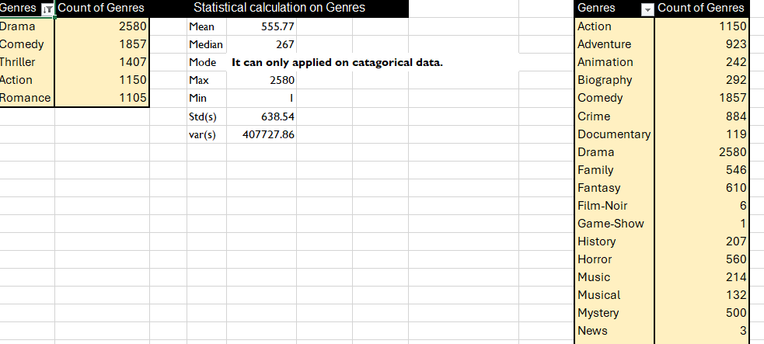
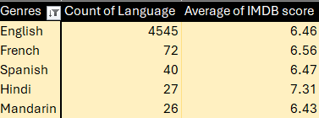
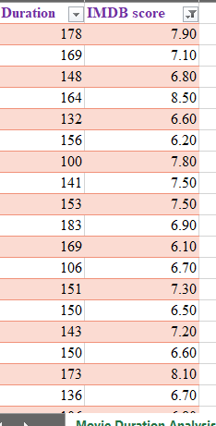
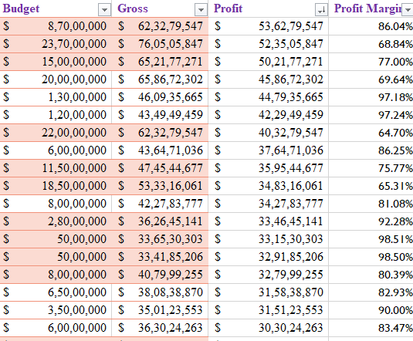
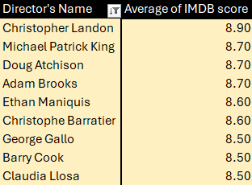
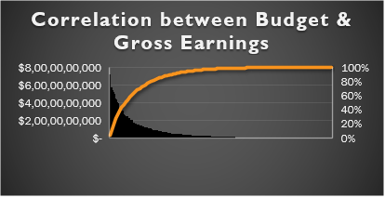

Slide 7
Duration Analysis
Objective: Check if longer movies score higher on IMDB.
Approach: Calculated mean, median, and standard deviation for movie durations; used a scatter plot with a trendline.
Outcome: Found a moderate positive relationship between duration and rating.
Next, I explored if movie length has any impact on ratings. I calculated typical durations and used a scatter plot with a trendline to examine any correlation. While the relationship was moderate, the data showed that slightly longer movies tend to score higher on IMDB.

Slide 8
Language Analysis
Objective: See if language affects IMDB scores.
Approach: Calculated average IMDB scores for each language.
Outcome: Some languages had higher average ratings, possibly due to niche audiences.
In this analysis, I examined how movie ratings varied across different languages. I used Excel to count the number of movies by language and calculate average IMDB scores. The results showed that while English dominates, some foreign-language films have high ratings, possibly due to niche appeal.

Slide 9
Director Analysis
Objective: Identify top-performing directors by IMDB scores.
Approach: Used the PERCENTILE function to highlight directors with scores above the 90th percentile.
Outcome: Found directors with consistently high-rated movies.
Directors can heavily influence a movie’s success. I calculated each director’s average IMDB score and highlighted top performers by focusing on the 90th percentile. This showed which directors consistently produce well-received movies and helped identify influential figures in the industry.

Slide 10
Budget and Profitability Analysis
Objective: Explore the budget-profit link.
Approach: Calculated the correlation coefficient and profit margin.
Outcome: High budgets often led to higher gross earnings, but profit margins varied widely.
Finally, I looked at budgets and their relationship with gross earnings. Using Excel’s correlation function, I found a strong link between higher budgets and greater earnings. I also calculated profit margins to see how spending relates to profitability, with some movies achieving substantial returns.

Slide 11
Tech Stack
Microsoft Excel 2019: Statistical analysis functions (AVERAGE, MEDIAN, STDEV, etc.), scatter plots, trendlines.
Microsoft Excel 2019 was the primary tool for this analysis. It offered statistical functions and visualization capabilities, which were crucial for deriving insights. Excel’s AVERAGE, MEDIAN, STDEV, and other functions helped me efficiently analyze and visualize the data.

Slide 12
Key Insights
Genres: Some genres are consistently rated higher.
Duration: Moderate positive relationship with IMDB scores.
Languages: Foreign-language films can have high average ratings.
Directors: Top directors have a strong impact on ratings.
Budget: Strong budget-to-earnings correlation, with variable profit margins.
This analysis produced some valuable insights: Certain genres are favored by audiences; longer movies tend to score slightly better; certain languages, especially non-English films, had high average ratings; top directors impact movie quality; and there’s a clear link between budget and earnings

Slide 13
Conclusion
Summary: Identified factors influencing movie ratings and profitability.
Applications: Insights can help guide future movie production and marketing strategies.
To sum up, this project helped identify important factors that influence a movie’s success, such as genre, language, duration, and budget. These insights are useful for understanding movie trends and could help in decision-making for future movie productions and marketing.

Slide 14
Thank You
Thank you for your attention! Note: “Connect with me on GitHub: github.com/Hrick91/IMDB-Movie-Analysis”

